Slide 1



Getting started with Polars (when DataFrame gets little too )
Mohammed Fazalullah “Faz”
Senior Developer Advocate
Amazon Web Services

Slide 2
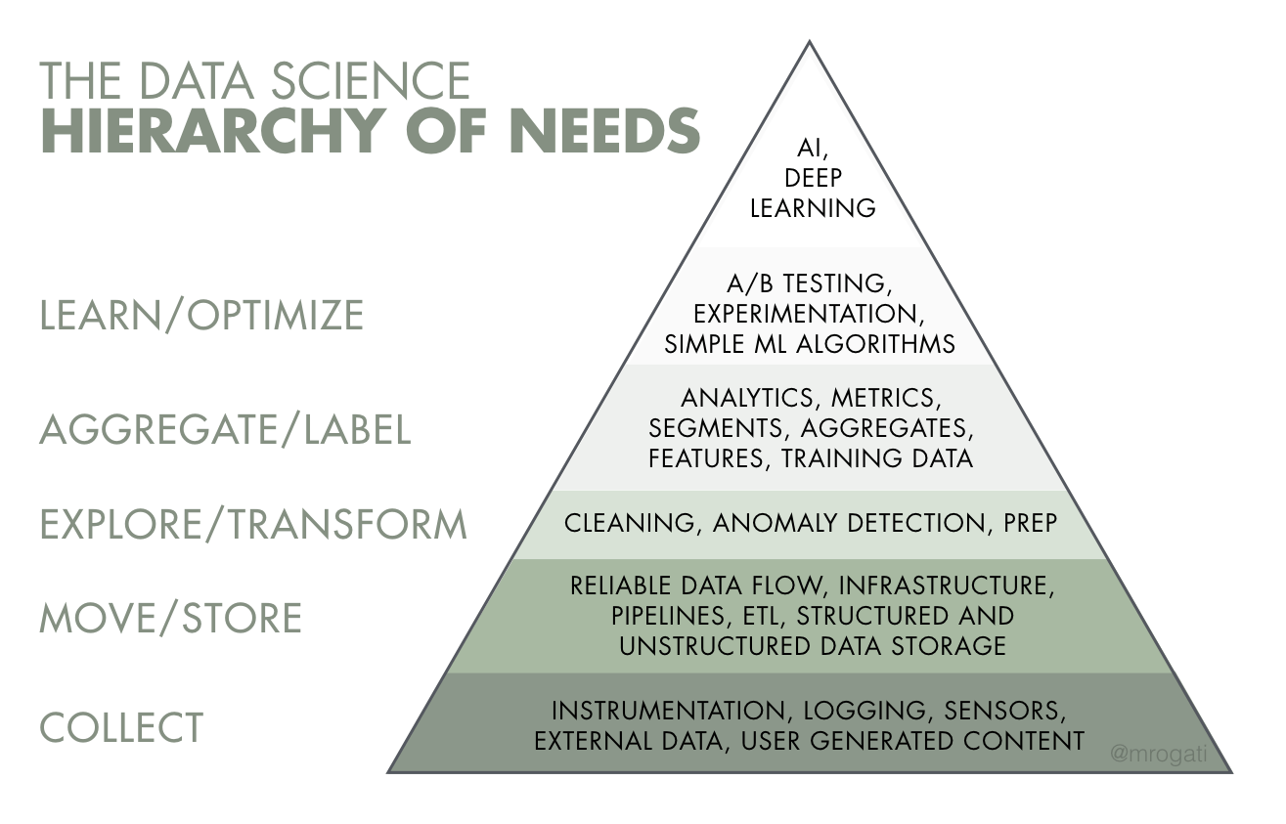
Foundations of data science
https://towardsdatascience.com/the-data-science-pyramid-8a018013c490

Slide 3
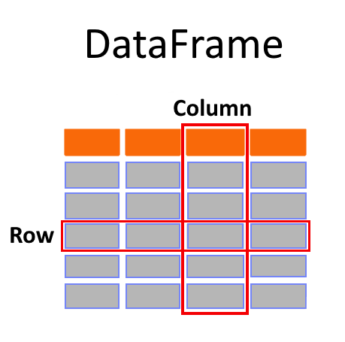
The humble DataFrame
https://towardsdatascience.com/rust-polars-unlocking-high-performance-data-analysis-part-2-7c58a3cb7a1f
Notes:
A DataFrame is a data structure that organizes data into a 2-dimensional table of rows and columns, much like a spreadsheet.
A simple analogy is that a DataFrame is like a spreadsheet with named columns. However, the difference between them is that while a spreadsheet sits on one computer in one specific location, a DataFrame can span thousands of computers. In this way, DataFrames make it possible to do analytics on big data, using distributed computing clusters.

Slide 4






world of df
Notes:
Pandas widely used
Rapids if you want to leverage GPUs
Spark if you want to use across distributed systems

Slide 5
Choosing between libraries
Computing performance
Technology stack match
Code compatibility
Popularity
Notes:
There is no single technology that is best in absolute terms to solve all the problems and situations that may arise during your data science workflows. Various factors have to be balanced before making a choice. Here are some of the most relevant factors to consider:
Computing performance. As a rule of thumb, the bigger and more complex the project, the more you should consider high-performance tools to avoid computing bottlenecks.
Technology stack match. The tools used in a data science project rarely work in a vacuum. Rather, they work in combination with the other tools comprising the technology stack. Before making any choice, you should be mindful of the synergies and fits between technologies.
Code compatibility. Choosing a new technology is also about code compatibility and efficiency. If adopting a new tool will result in rewriting code in existing projects, you should include that in your calculus.
Popularity. Finally, the popularity of a tool is a proxy of how many people use it, which can be advantageous for the purpose of hiring new developers or solving coding doubts in platforms like Stack Overflow.
https://www.datacamp.com/tutorial/high-performance-data-manipulation-in-python-pandas2-vs-polars

Slide 6

Its really fast …

Slide 7
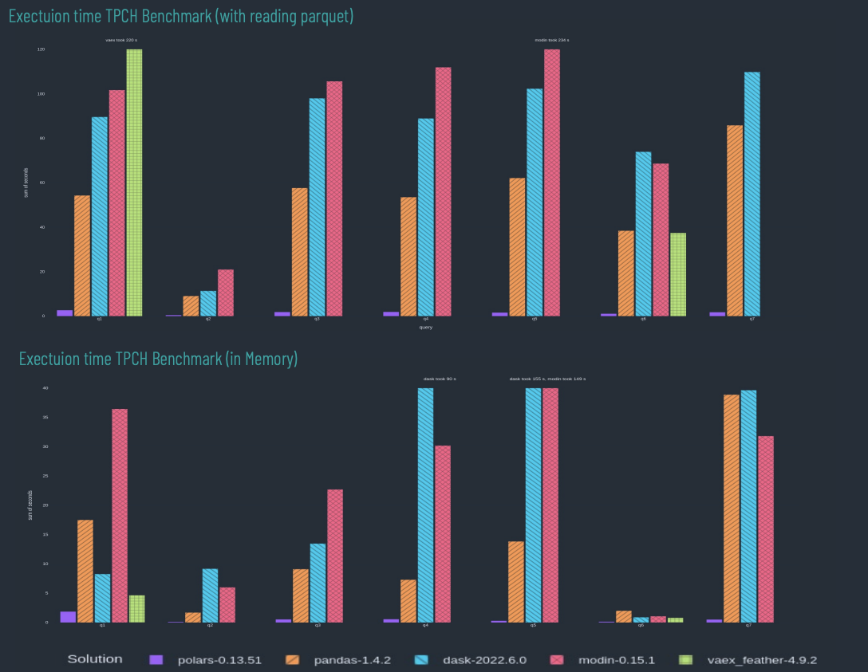
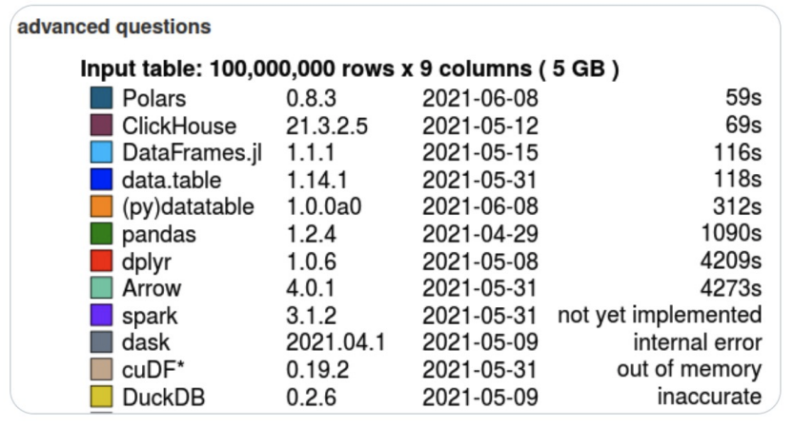
Its really fast …
Notes:
but uh just a few stats which I just pulled from their website this is a tpch
benchmark which is typically used for the sequential as well as uh random
workload for databases uh typically and if you see um uh this test was uh executed on I
think 10 more than 10 millions of row and nine columns roughly around 5 GB of data and you can see that uh you know
polars could do those operations in 59 seconds whereas other libraries like
pandas is almost thousand uh 90 seconds so and in this chart if you see uh the
purple one which is almost uh touching the x-axis uh that is the performance of
that polars can give you

Slide 8

polars
powerful data manipulation and analysis library
written in Rust (created by Ritchie Vink in 2020)
uses Apache Arrow
native arrow2 Rust implementation
available with multiple languages
python, rust and NodeJS
memory efficiency
similar to Arrow, which reduces memory overhead and improves memory utilization
expressive API
Chains of expressions build an optimized query plan
Interoperability
integrates seamlessly with other data processing frameworks, such as Apache Arrow, enabling efficient data interchange between different systems
Notes:
Apache Arrow is an open source cross-language project to store tabular data in-memory.
Polars represents data internally using Apache Arrow arrays while Pandas stores data internally using NumPy arrays.
polars what it is
at its core it’s data manipulation analysis library and you can if you are
coming from uh pandas background you can think of this as an alternative to uh
pandas and what makes this special is uh it's written in a rust which makes it uh
very Dynamic especially in the garbage collection and the memory optimization
because of the language itself and uh one of the key thing of collage is uh it
is uh very memory efficient and we will touch base on that you know why we are
saying that it is memory efficient and it uses uh Apache Arrow 2 uh the
last implementation so that's a native implementation that has been taken by polars so that also means that the
libraries which uses um by Arrow under the hood can make use of
polars so if let's say you are using polars which is built on top of uh
Apache PyArrow and now let's say you have spark which also let's say uses
Apache Arrow so you know there is a nice interoperability between uh two higher
level apis so you don't have to you know copy the whole data under the hood in
case you want to transfer the data or in case you want to manipulate the data across different libraries so that
interoperability you get because of the Apache Arrow under the hood
the other thing is it has an expressive API and again I'll talk more about what
this means with example

Slide 9
key features
fast flexible analysis with the Expression API
easy parallel computations
automatic query optimization in lazy mode
streaming to work with larger-than-memory datasets
Notes:
key features
are it has an expressive API um it it make use of all the cores in
your computer or in your server to execute any operation unlike let's say
uh pandas which is mostly skewed towards one of the cores so you you don't get that much of uh you know uh parallel
execution uh with the native pandas although we have some additional uh
modules now which kind of makes pandas parallel but it is not natively but
polars is natively parallel and one of the uh interesting thing about uh
polars which actually makes it makes it very fast is the lazy execution so and
this is what uh I will explain in the demo which will make more sense you know rather than talking uh try here

Slide 10
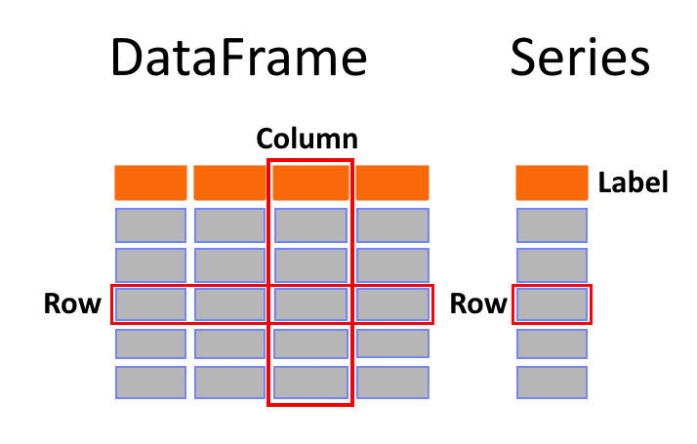
Core objects
https://towardsdatascience.com/rust-polars-unlocking-high-performance-data-analysis-part-1-ce42af370ece
Notes:
The Series object is a crucial data structure in Polars, representing one-dimensional, or 1-D for short, information. It combines the features of both a vector and HashMap by having an ordered sequence with labels for easy retrieval. A simple analogy would be to imagine one column that stores actual data values with a label. This makes managing large amounts of structured data more accessible and effective within your codebase.
At the heart of the Polars library lies an essential component that serves as its foundation; The DataFrame structure. This ingenious two-dimensional data representation is organized in rows and columns, similar to a series object but with added dimensions.

Slide 11
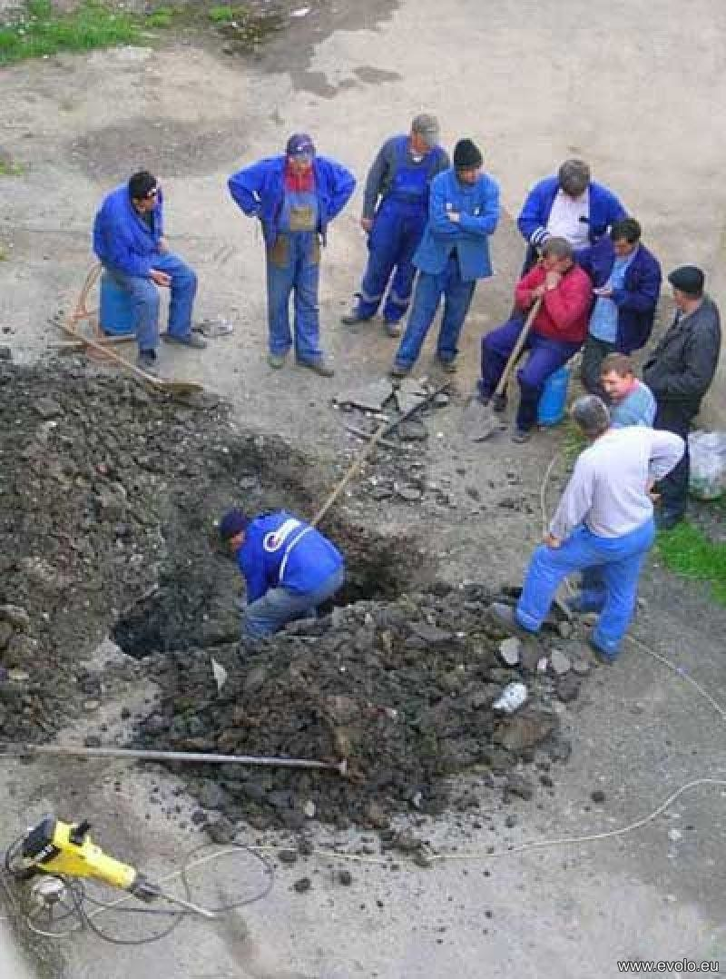
embarrassingly parallel
without parallelization
CORE2
CORE1
CORE3
GPU
CORE5
CORE7
CORE4
CORE6
Notes:
all right so now when we think about stiffness or uh
uh performance one way that we can execute our code fast is by making use
of our Hardware efficiently so let's say if you have a system with multiple cores
and gpus now if you are not making use of all the cores without parallel
parallelization we won't get the best out of it right

Slide 12

embarrassingly parallel
without parallelization
multi-core parallelization done wrong
CORE2
CORE1
CORE3
GPU
CORE5
CORE7
CORE4
CORE6
Notes:
so this is what typically happens in the modules like uh
pandas now what we want is we want to make things
parallel and there are few modules uh like we have Dusk and all of that which
can and mode and which can make things better but it cannot go beyond that so we need to make sure that we parallelize
our operation in the right way right so it's not like uh just hiding the drawbacks and putting the sugar on top
of it to make it work uh to some extent s

Slide 13
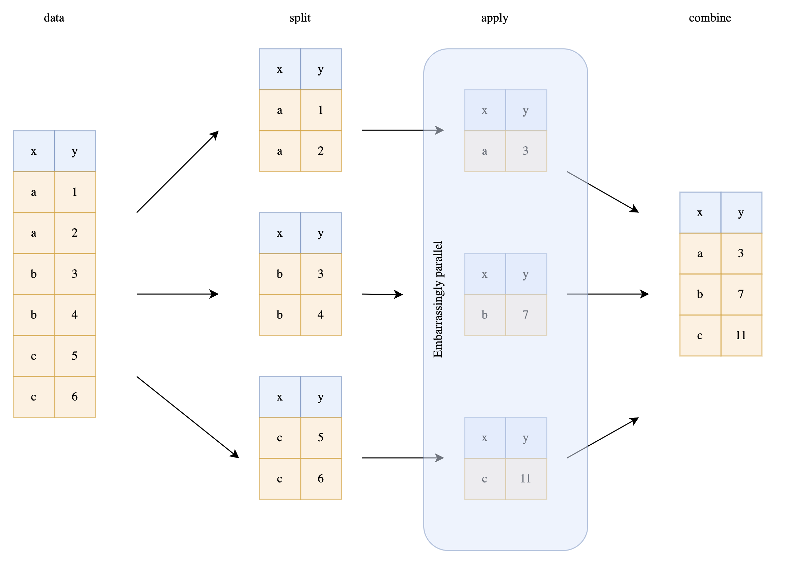
parallelization
embarrassingly parallel
aggregations across different cols
groupby operations can be parallelized
https://www.ritchievink.com/blog/2021/02/28/i-wrote-one-of-the-fastest-dataframe-libraries/
Notes:
so the way that we get uh
parallelization in polars is in different ways so the very basic at its
very core let's say you have a data like this uh we have some uh column X and Y
and let's say you want to do some group by operation so one simple way to do
this is we split the data and then we just apply the transformation in all the
groups of data uh you know separately so all this operation can happen in parallel but the condition for this is
uh we should not have uh same key in two different partitions right so if that is
not the case then we can simply use a native map reduce kind of task where we
just split the data and then we perform some um uh you know uh apply operation
or we just do some reduce operation and then we just combine that and this this
works well but the condition is the all the teeth should be separate uh in all
the different workers but that is not the case in in the real world but whenever this happens polars will make
use of this uh you know splitting the data and applying the transformation so that is a very straightforward way to uh
uh get uh parallelization but this is not idle in the in the real world

Slide 14
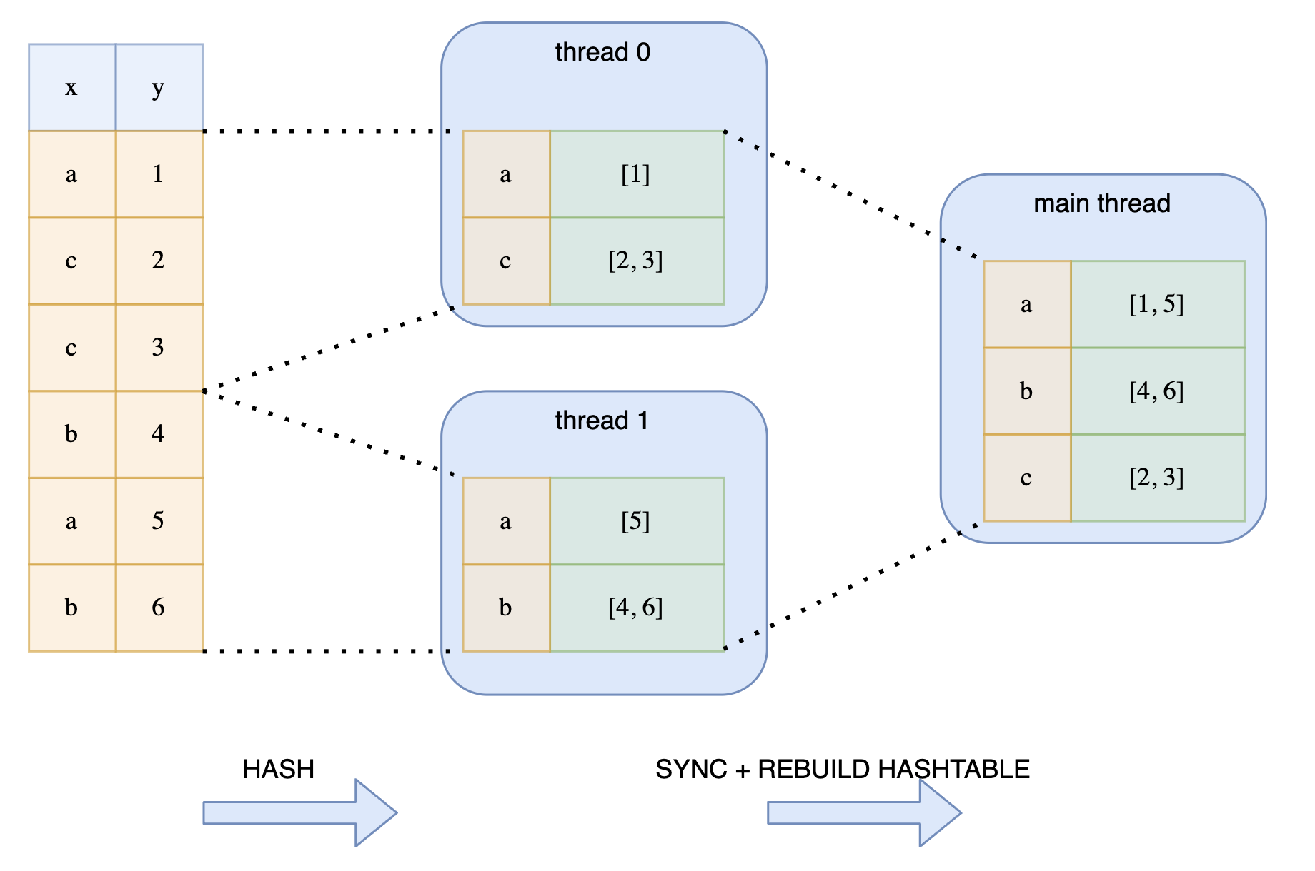
parallel hashing
Expensive synchronization
data split into threads
each thread applies operations independently
there is no guarantee, that a key doesn’t fall into multiple threads
extra synchronization step necessary
https://www.ritchievink.com/blog/2021/02/28/i-wrote-one-of-the-fastest-dataframe-libraries/
Notes:
so in
real world the data would be mixed so uh assume that you have the same data and now
what you can do is you can take the first half of the data and send it to
thread 0 and the second half the data send it to thread one so here you can consider thread 0 as CPU 0 and thread
one as CPU one and then you try to do the uh you know join Opera Group by
operation within uh each uh thread independently and this also works but
there is a condition that uh if you have the same key in both the threads you need to have uh some
mechanism so that you know both the threads can talk to each other and you should have the Locking and
synchronization in place because the grouping of this uh trade zero and grouping of uh thread one uh is not the
result that we are looking for right so because we have the same key

Slide 15
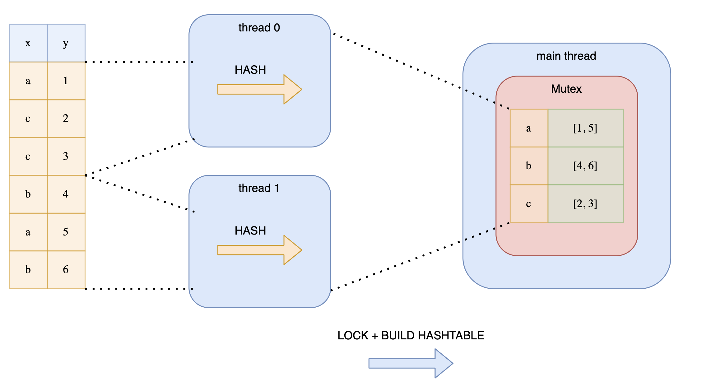
parallel hashing
Expensive locking
data split into threads
threads have shared storage (mutex) to prevent duplicates
but different threads blocks each other
https://www.ritchievink.com/blog/2021/02/28/i-wrote-one-of-the-fastest-dataframe-libraries/
Notes:
so to mitigate that we can have some some sort of hashing in
uh all the threads uh so that they can talk to each other and they can uh you know lock the memory uh whenever they
are working let's say thread zero is working so it will lock the memory uh and that point so that uh other threads
cannot uh write other on that particular location but this works but this will
add and uh hindrance because of uh intercommunication between the threads
and this will work fine if you have a four CPU core or let's say two CPU core uh it will work fine but the moment you
have 16 CPU core authority to CPU core there will be a lot of messaging going on across the course so this is not good

Slide 16
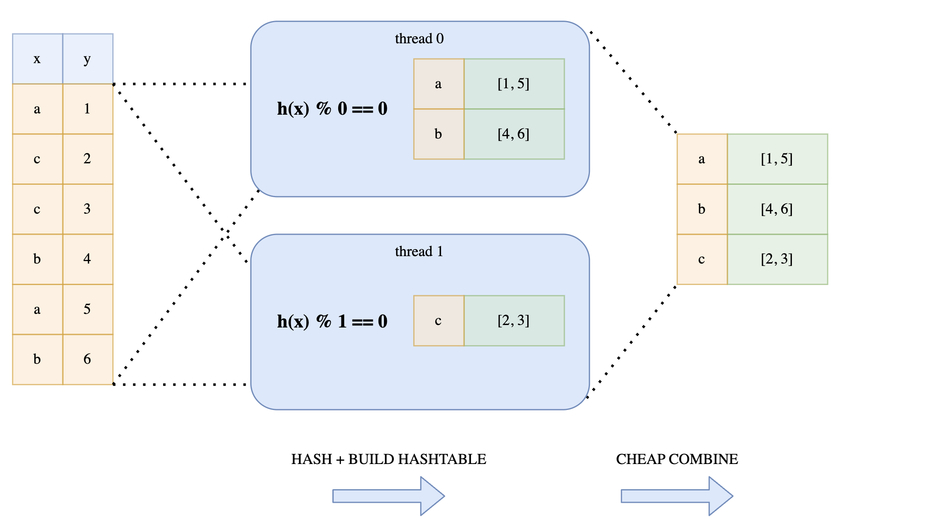
parallel hashing
Lock-free hashing
all threads reads the full data
threads independently decides which value to operate on by a modulo function
results can be cheaply combined by trivial concatenation
https://www.ritchievink.com/blog/2021/02/28/i-wrote-one-of-the-fastest-dataframe-libraries/
Notes:
and that's why uh what polars have implemented is something called log free hashing so
what it actually does is it says that okay you give all the data to each of the CPU
core so if you have let's say 16 CPUs you you give the data to all the 16 CPUs
so here we are taking an example of two CPU core but the same uh goes uh with
multiple CPUs now what it does is uh it has a hash function and a modulo
function and it will just filter out the keys which are assigned for that
particular thread so here if I if you see this we have a hash function and we are doing a modular Opera operation with
0 and this zero is because let's say this is a thread zero that's why it is zero so For Thread one it will be uh
percentage one similarly For Thread n it will be percentage n so what it essentially means is each CPU core will
take all the data and it will perform this hash function with the modulo and it will just keep the data which is
assigned or which is meant for that core and it will just uh ignore the other data
so that way you're always guaranteed that a particular key will only land
into uh or will be performed by only one of the threats now at the end what you
have to do is we just have to concatenate the whole data and this works very efficiently because there is
no uh locking across multiple threads or code now the only drawback here is when
you get the ultimate result uh they won't be in sequence which is still okay
because if you want anything to be sorted it's better to sort that beforehand and then perform this
operation so uh this is the only I would say uh a trade-off that data
won't be in in the order that you want but if you want the data to be in order it's better to do the ordering or
sorting beforehand so that's this is what makes um uh polars very efficient

Slide 17
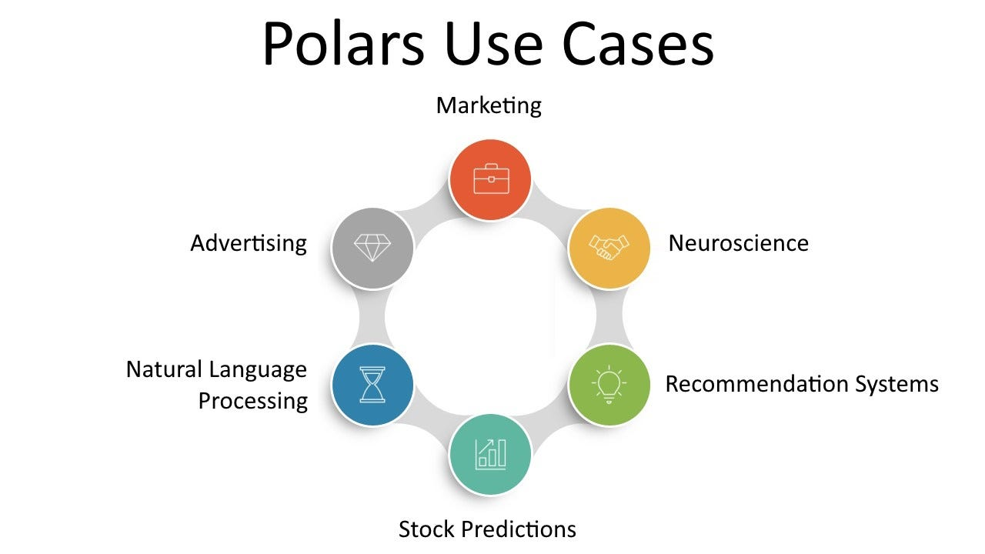
Polars use cases
https://towardsdatascience.com/rust-polars-unlocking-high-performance-data-analysis-part-1-ce42af370ece

Slide 18
What does a Data Engineer want?
# select/slice columns
select
# create/transform/assign columns
with_columns
# filter/slice/query rows
filter
# grouping dataframe rows
groupby
# aggregation
agg
# sort the dataframe
sort
Notes:
and fast and before we jump into the demo I just want to show you how a data how a data
engineer or uh especially data especially a data engineer really work with these kind of data so all they need
is few of this verbs like selecting few columns creating few columns filtering
some columns and then doing some group by or join operation and that's all
right

Slide 19
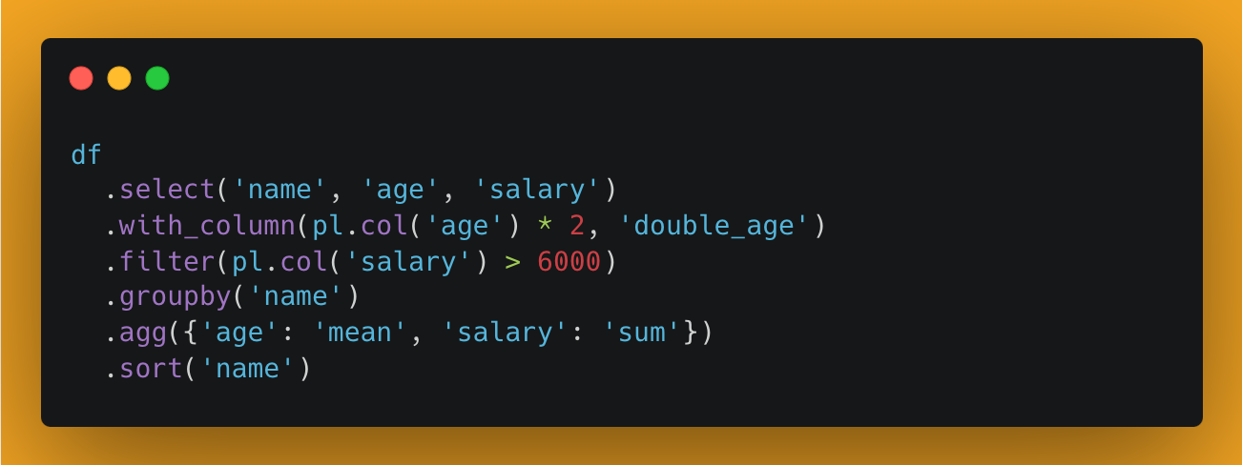
a Data Engineer – that’s all I want!
# select/slice columns
select
# create/transform/assign columns
with_columns
# filter/slice/query rows
filter
# grouping dataframe rows
groupby
# aggregation
agg
# sort the dataframe
sort
Notes:
so the way that uh this this would look like in the code is something like
this you just select few columns and then you can create a new column then you apply the filter then you apply the
group by and you apply the aggregation and then sorting if you need so if you
look at the syntax it's very clean and it's very readable and if you are coming from spark background this might uh you
know uh this might seem very familiar and the other thing here is
each each of this expression in all these lines they all get executed uh you
know in parallel and we are going to see that in the demo

Slide 20

I'm still growing ☺

Slide 21

lets get started
thecloudranger/pycon_polars101
↳ forked from debsuman/pycon_polars101

Slide 22
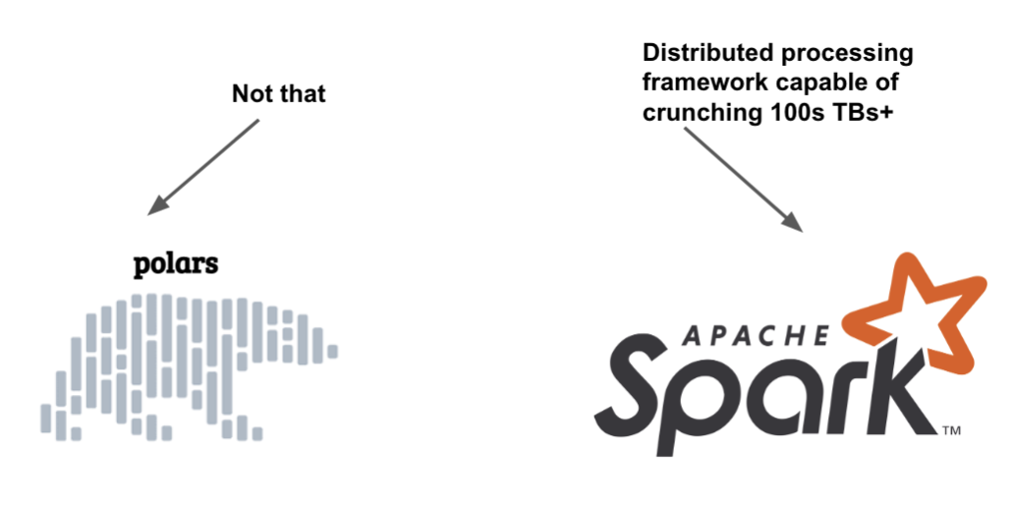
https://towardsdatascience.com/rust-polars-unlocking-high-performance-data-analysis-part-1-ce42af370ece

Slide 23
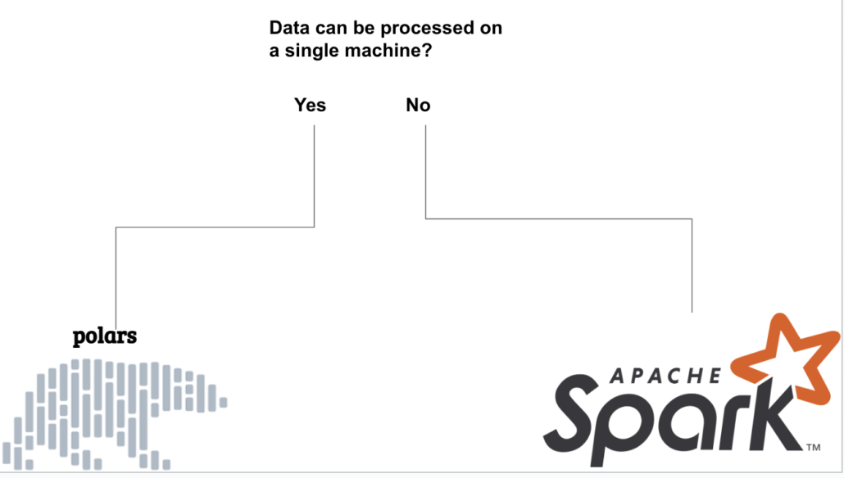
https://towardsdatascience.com/rust-polars-unlocking-high-performance-data-analysis-part-1-ce42af370ece

